Slide 1
Yammer Development Methodology

Slide 2
Overview
Conway’s Law
Services Oriented Development
Testing & Metrics
Cross Functional Teams
Specs, Staffing, Support
Summary

Slide 3
Conway’s Law
Organizations which design systems …
are constrained to produce designs
which are copies of the communication structures
of these organizations.
Notes:
Organizations which design systems … are constrained to produce designs which are copies of the communication structures of these organizations.
What does this mean?
You ship your organization
If you have three teams each working independently on a product you’ll end up with three independent parts of the product

Slide 4
Product
Organization
Architecture
Notes:
As Conway’s law states, the organization shapes the product
Also, because of how heavily we use the product, it also shapes our organization

Slide 5
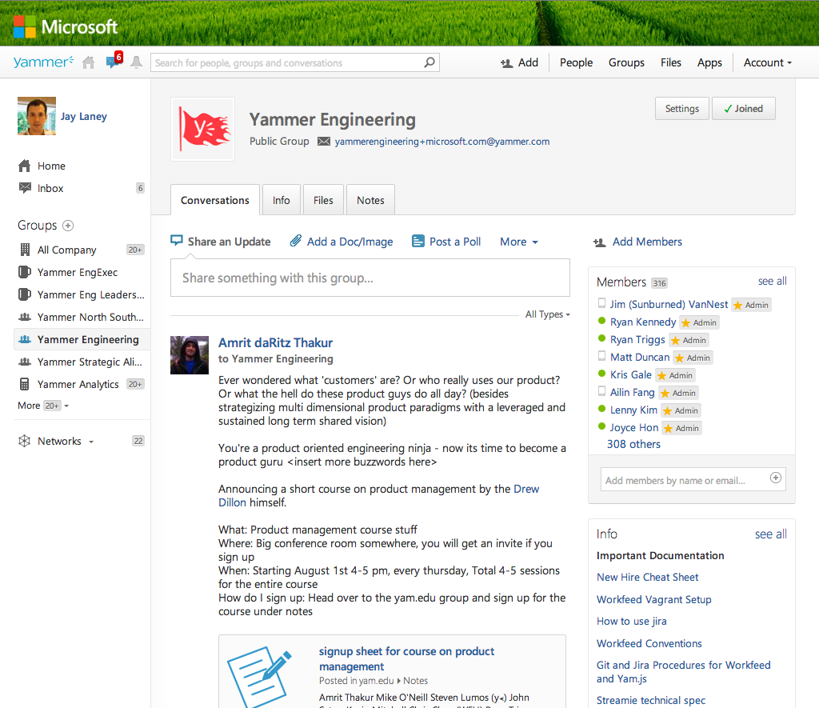
Notes:
First, what is Yammer?
An enterprise social network
Empower employees through decentralization and transparency
We believe that employees make better decisions when they have the more context
Transparency leads to a better and healthier organization

Slide 6
Shipping a service
Traditional companies optimize MTBF
Track a moving target
Enable MTTR optimization
System and product MTTR

Slide 7
Testing assumptions
We’re wrong 66% of the time
MTBF is costly when you’re wrong
A/B test every feature
Optimize MTTR with short cycles

Slide 8
Shorter cycles means more course correction
Q4
Q1
Q3
Q2

Slide 9
How do other companies organize?

Slide 10
Search
Messaging
Files
HTML
JS
Java
Ruby
HTML
JS
Java
Ruby
HTML
JS
Java
Ruby
Notes:
Traditionally, engineering orgs are split up in one of two ways.
In this case, teams are split based on product areas
This leads to prioritization issues since the search team always thinks search is most important
To change prioritization, the org chart has to change

Slide 11
Office
OSS
SharePoint
Exchange
OCS
…
…
...
Notes:
Implicit prioritization is created by the org chart

Slide 12
Search
Messaging
Files
Frontend
Search
Messaging
Files
Middle-Tier
Search
Messaging
Files
Backend
Notes:
The other traditional way is to split into functional areas.
This silos information and provides bad incentives in the opposite direction
Projects now focus on tech stacks instead of the end user
Their incentivized to optimize their world rather than making the best tradeoffs for the user

Slide 13
How do we organize?

Slide 14
Functional Teams
Consolidate experts and code stewards
Create a source of best practices
FE, API, Clients, Core, Infra, Analytics & QA
Change requires re-organization

Slide 15
Cross-Functional Teams
Execute work in small teams
Ensure full representation from functional teams
Autonomous
Quickly react to changing priorities

Slide 16
How an Idea Becomes a Feature
Notes:
Let’s talk a bit about product lifecycle:
First, where do idea come from?
Talking to customers, research, guessing, drunken epiphanies. Exactly where you’d expect.

Slide 17
Metrics Based Specs
Metrics for Success
Improvement to number of users who complete the sign up flow
Lift in both 1 and 7 day retention
Lift in engagement binary and days engaged among new users
Higher proportion of users with complete profiles and photos uploaded
Group membership isn’t negatively impacted
Invite conversion rate in sign-up isn’t negatively impacted if we remove the ability to add a photo
Number of desktop downloads amongst new users isn’t negatively impacted
Notes:
The first step is for our product team to put together a spec.
Very simple, primarily just screenshots and a few notes
Always metrics based
Metrics drive decisions and determine whether we were successful or not

Slide 18
Limiting Scope: 2-10 Weeks
Test in small iterations
Prevent over-building & over-investing
Preserve a sense of urgency
Increase collective breadth of knowledge

Slide 19
Limiting Scope: 2-10 Engineers
Ensure full representation from functional teams
Domain experts prioritize refactoring
Cross-train during downtime
Guided mentorship by functional experts

Slide 20
Assigning Work
Scale a traditional management hierarchy
Individuals have the best vantage point
Prioritize refactoring along with features
Achieve incremental improvements

Slide 21
Tech Leads
Single technical point of contact
Gather and communicate estimates and status
Organize and document technical scope
Role not rank!

Slide 22
Focus
Engineers assigned to one project
Improve estimate quality
Reduce context-switching overhead
Create accountability

Slide 23
Support Engineering
Isolate interruptions
Improve retention
Improve code quality

Slide 24
Transparency
Provide visibility into autonomous execution
Work in the open, in a Yammer group
Use our own product to build our product

Slide 25
Cross Functional Model
Eliminate external dependencies
2-10 dedicated people
2-10 weeks
Led by assigned Tech Lead
Work in public
Validate assumptions!

Slide 26
Iterate

Slide 27
Will it Scale?

Slide 28
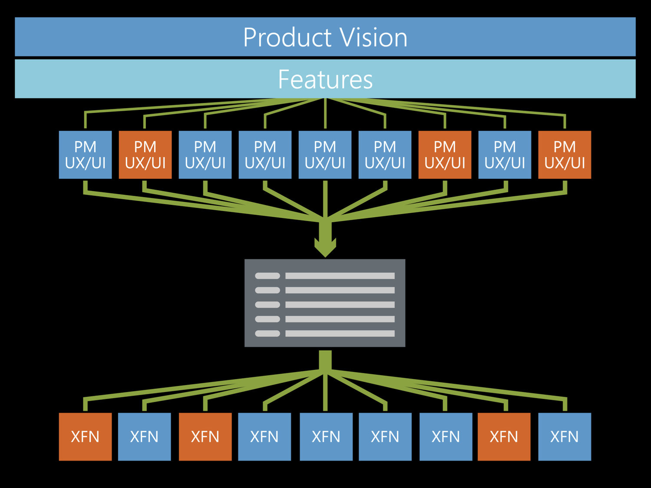

Slide 29
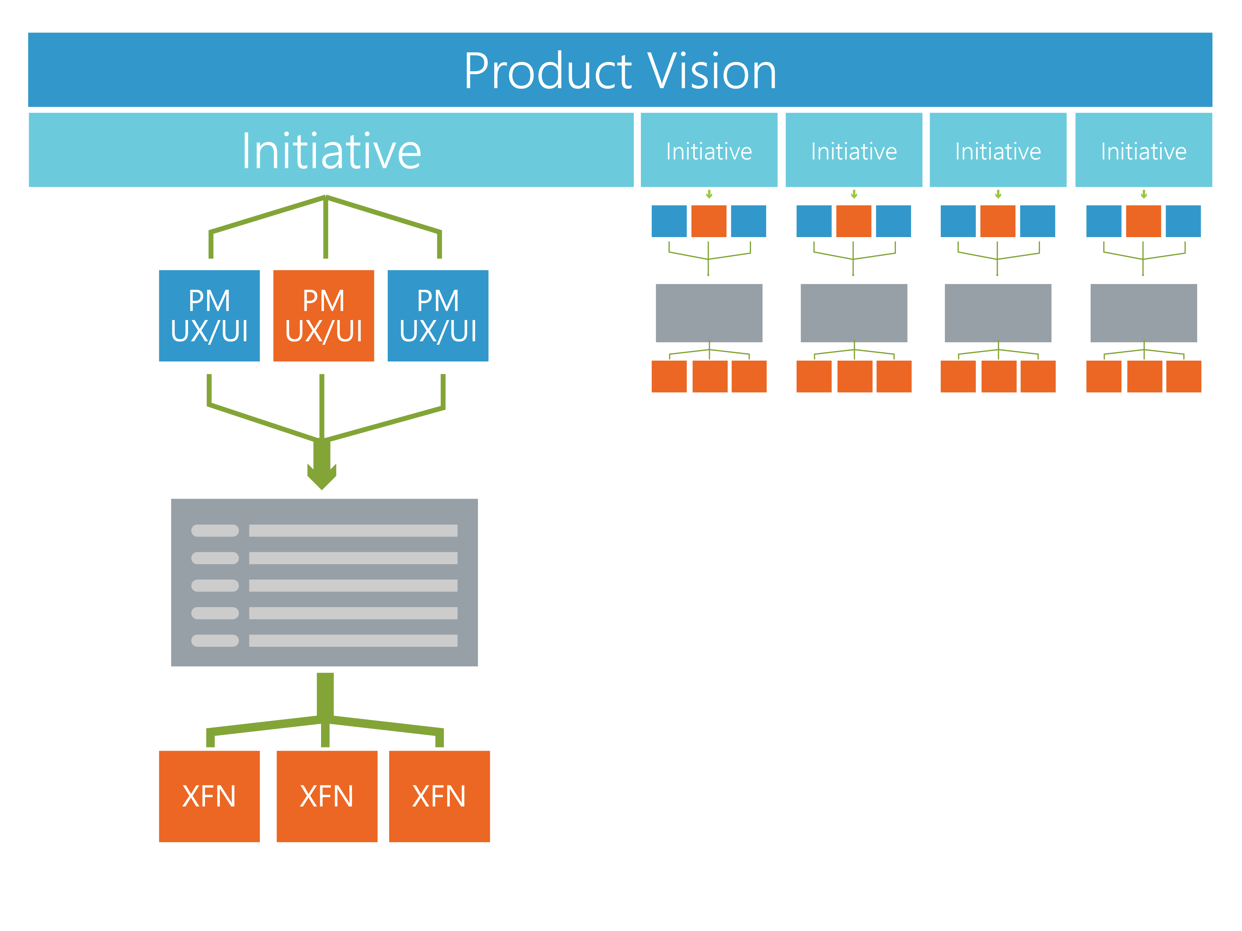

Slide 30
Questions?

